Slide 1
SQL LOADER & XML Report

Slide 2
Agenda
SQL Loader - Introduction
Loader Files
Loader Invoking Methods
Loader Example
XML Report – Introduction
XML Templates
XML Report - Example

Slide 3
SQL Loader Introduction
SQL Loader is Oracle utility that allows you to load data from a flat file into one or more database tables
Tables must be created first
A typical SQL Loader session takes as input a control file, which controls the behavior of SQL Loader, and one or more datafiles. The output of SQL*Loader is an Oracle database (where the data is loaded), a log file, a bad file, and potentially, a discard file

Slide 4
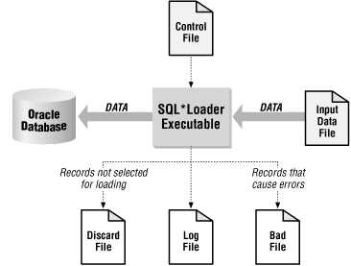
SQL Loader Overview

Slide 5
SQL Loader Files
Data File
Control File
Log File
Bad File
Discard File

Slide 6
Control File
The Control File information
Syntax
Specifies the action
Insert
Replace
Append
Specifies the data file name and list of fields
Has an extension .ctl
load data
infile 'example1.dat' "fix 11"
into table example
fields terminated by ',' optionally enclosed by '"'
(col1, col2)

Slide 7
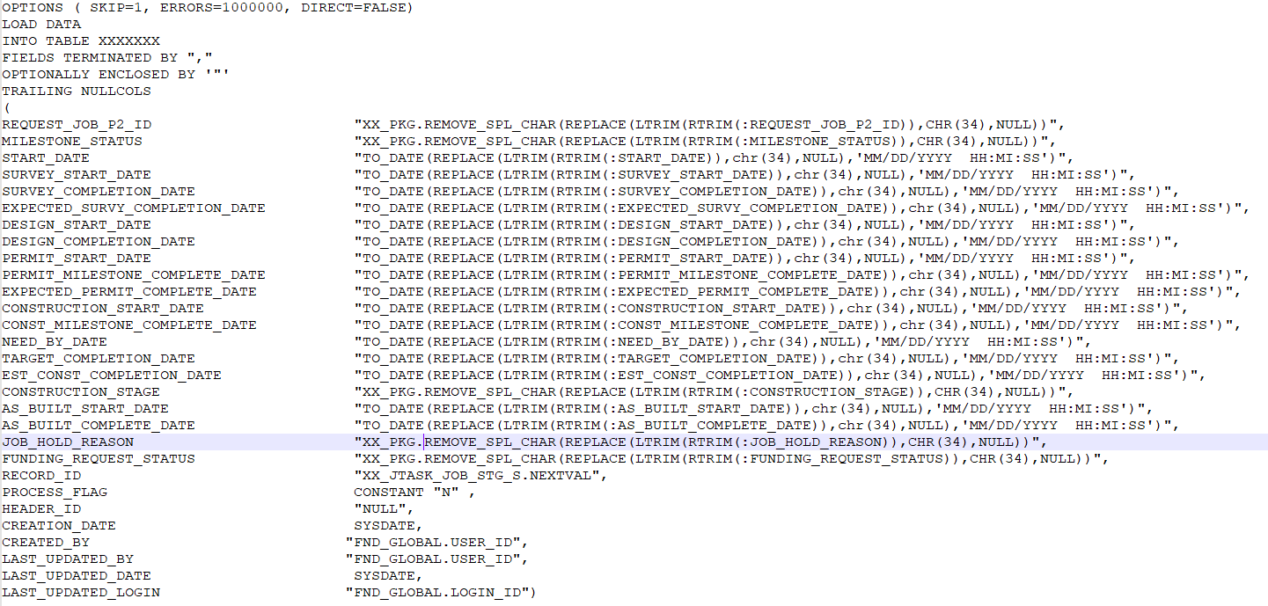
Sample Control File

Slide 8
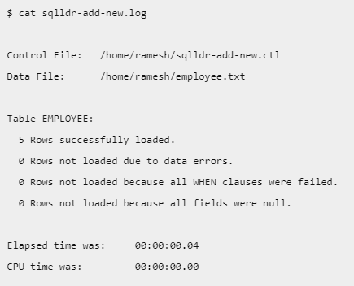
Bad File
Log File
The bad file contains rows that were rejected because of errors.
These errors might include bad datatypes or referential integrity constraints.
Has an extension .bad
When SQL*Loader begins execution, it creates a log file. The log file contains a detailed summary of the load.
This will create the output log file in the same name as the data file, but with the .log extension
Discard File
Store the records that are neither inserted into table nor rejected as bad.
This is an optional parameter with SQL Loader and by default name would be .dsc.
As the name indicates these records are discarded by the SQL Loader because they were filtered out with the record selection criteria mentioned in the control file commands.

Slide 9

Invoking Loader
1.Command-Line Parameters
When you invoke SQL*Loader, you specify parameters to establish session characteristics. You can separate the parameters by commas, if you want to

Slide 10
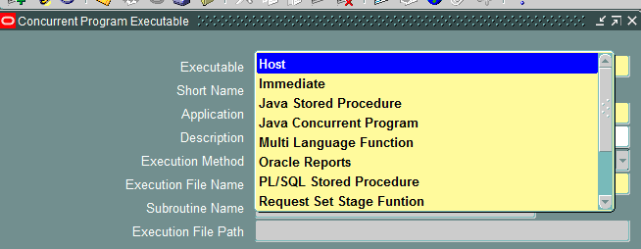
Invoking Loader
2.From EBS
Using the below methods, we can invoke Sqlloader from EBS
Host – Call the Sqlloader using Shell Script
File with extension.sh

Slide 11
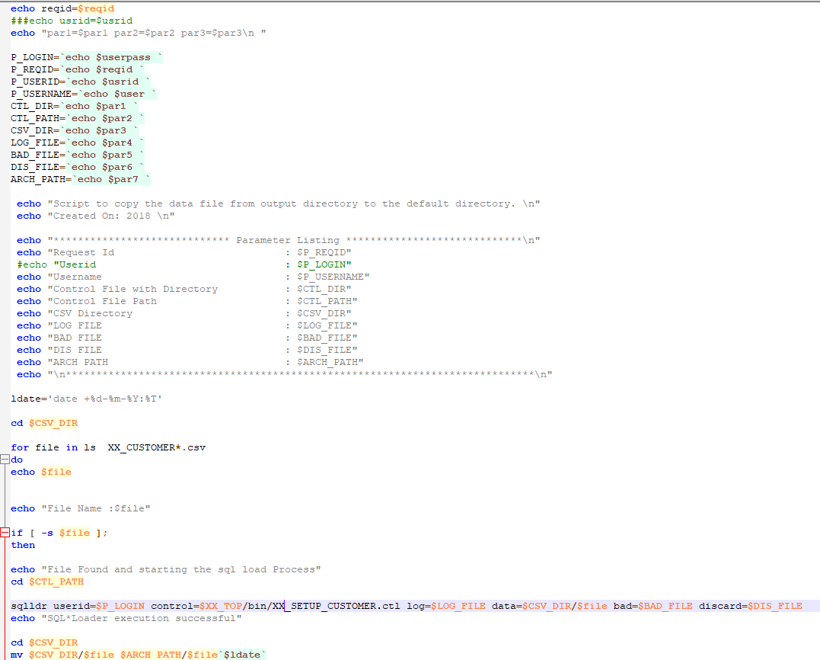
Sample Host File

Slide 12
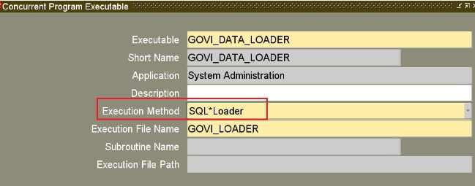
Invoking Loader
SQL Loader
Create SQL Loader Concurrent Program executable

Slide 13
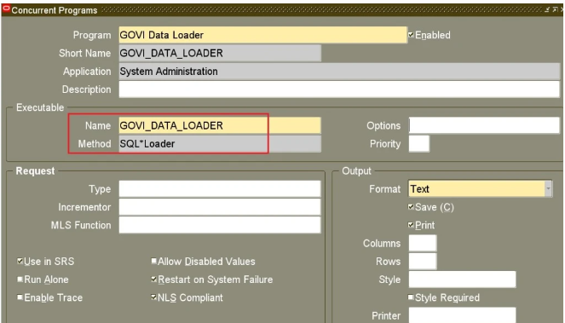
Invoking Loader
SQL Loader
Create Concurrent Program and attach above created executable

Slide 14
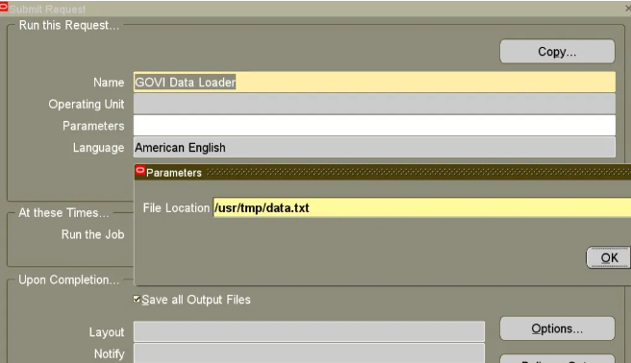
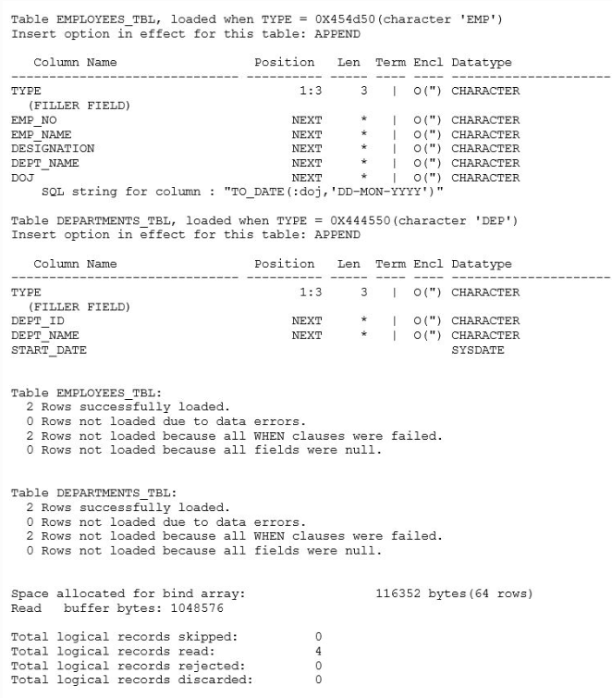

Slide 15
Sample Files

